Slide 1


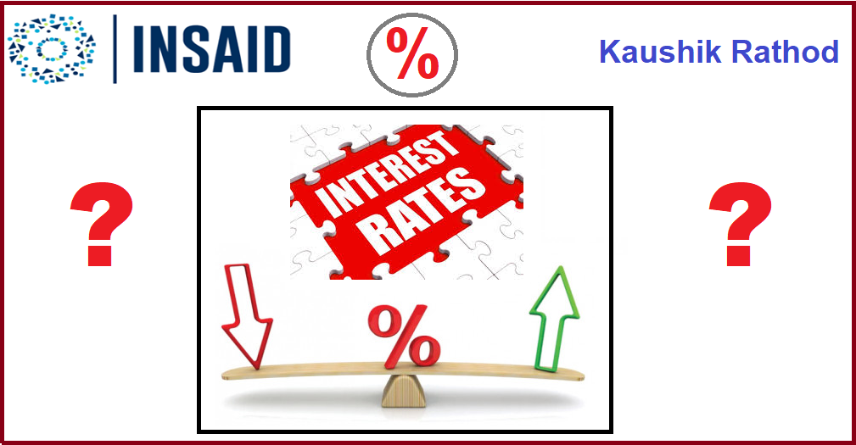


INTEREST RATE PREDICTION
By: Kaushik Rathod
Batch: Mar - 2020

Slide 2
PROBLEM STATEMENT
Identify best Interest Rate for different types of Loan
applications with help of given dataset, dataset
has many types of loan applications with Interest Rate
along with other details
We needs to create a different types of model and
analyze which will predict best Interest Rate for new
applications

Slide 3
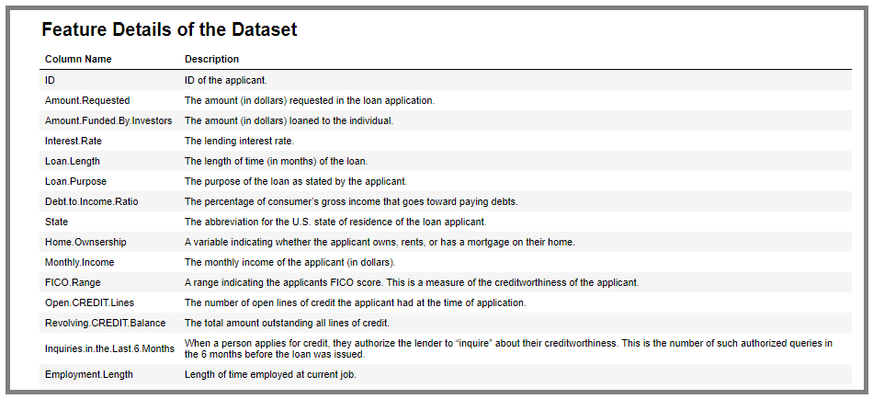
DATASET FEATURES
Dataset has total 2500 rows and 15 columns

Slide 4
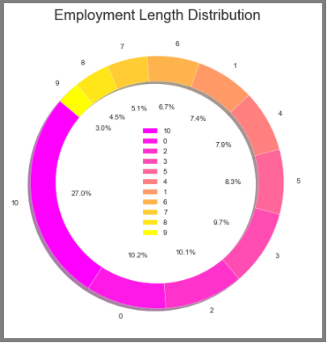
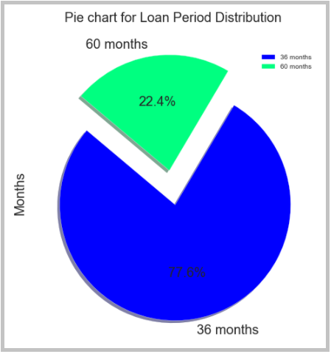
EDA

Slide 5
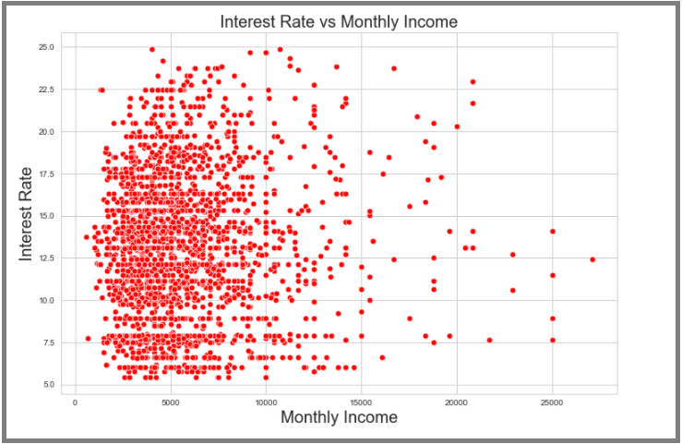
EDA

Slide 6
ASSUMPTIONS
As per problem statement our Target Variable is ‘Interest Rate’
so this is not a categorial but its a regression problem
Performed data cleanup, removed outliers and removed some
columns which are not relevant for analysis
Also added some logical columns for analysis

Slide 7
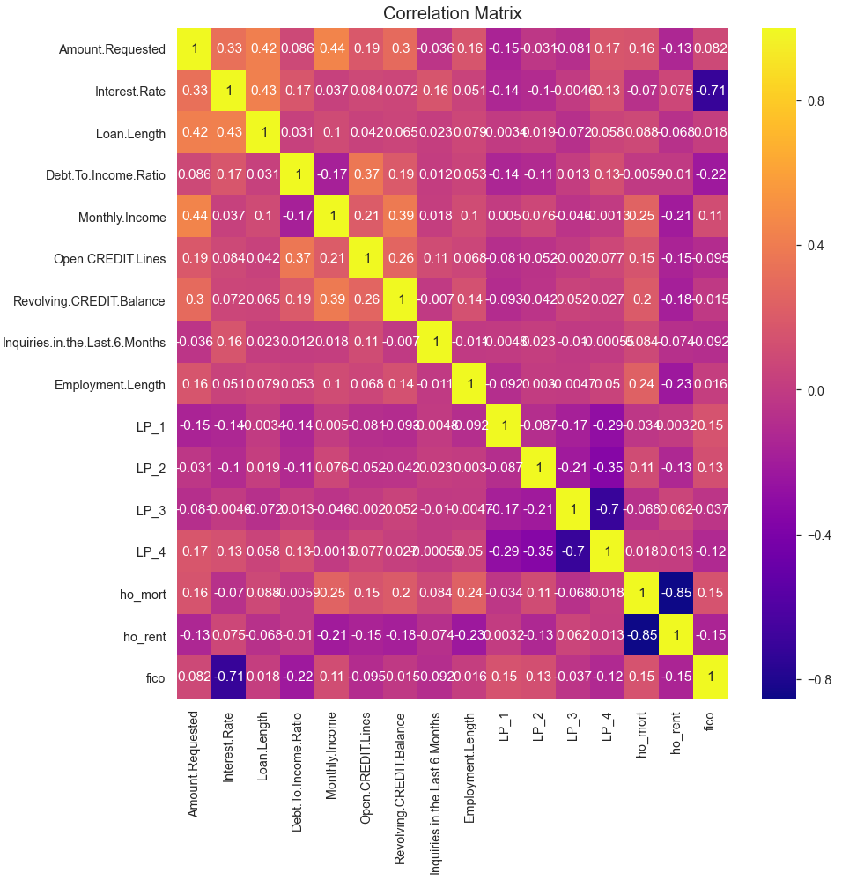
CORRELATION
Correlations can vary from -1 to +1. Closer to +1 means strong positive correlation and close -1 means strong negative correlation. Closer to 0 means not very strongly correlated. Variables with strong correlations are mostly probable candidates for model building.
There is a negative correlation between Interest Rate and Fico (Rating) are -0.71, it means if Fico value is high as Interest Rate will be low.
There is a negative correlation between ho_mort
and ho_rent columns with a value -0.85 because
both of these column are the dummy variables of the
column Home.Ownership from the original dataset.
There is also a negative correlation between LP_3
and LP_4 columns with a value -0.7 because both of
these column are the dummy variables of the
column Loan.Purpose from the original dataset.

Slide 8
MODELS
We have used 3 different types of models for prediction based on evaluation metrics
Linear Regression
Decision Tree
Random Forest
We used MAE, RMSE , R Square and Hyper-Parameter tuning for prediction of the model based on accuracy score

Slide 9
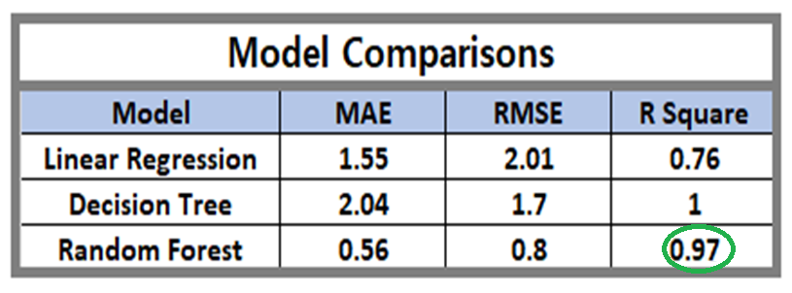
EVALUATION
As we can see in the table Random Forest with R Square has good score 0.97 and in test data set also score is similar, similar way Decision Tree had R Square is 1 but it may overfitting. We have done Hyper-Parameter Tuning of Random Forest, It’s not changed much.
Finally as per current analysis Linear Regression with R Square is good model for Interest Rate.

Slide 10
CONCLUSION
In all prediction Random Forest Model is looks good so far.
R squared values for training and test is very small, it indicates that our model is not overfitting on the training set and is generalizing well on the test set.
As a result we can say that our model will be able to make good predictions on new data and will help them to provide suitable Interest Rate to the new applicants based on their applications.

Slide 11
THANK YOU!
By: Kaushik Rathod
Batch: Mar - 2020

